Slide 1
R Studio Tutorial

Slide 2


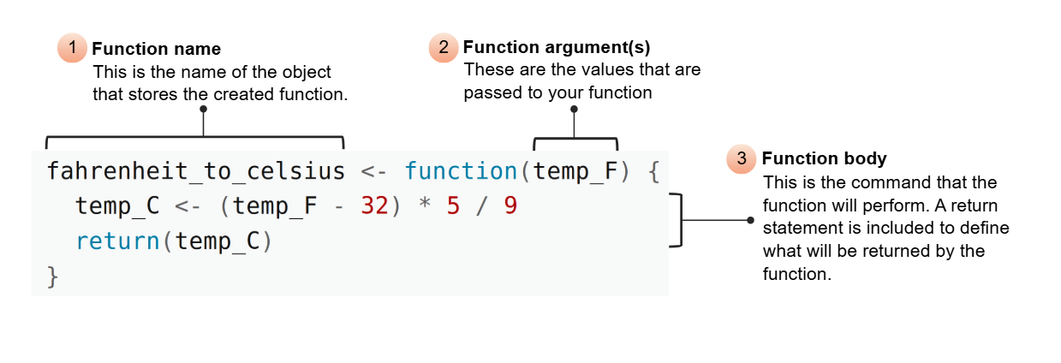
What is R? What is R Studio?
R is a coding language similar to what we learned last week on the terminal BUT, syntax is different
R studio is an app that helps us you the R coding language and visualize the code in real time

Slide 3
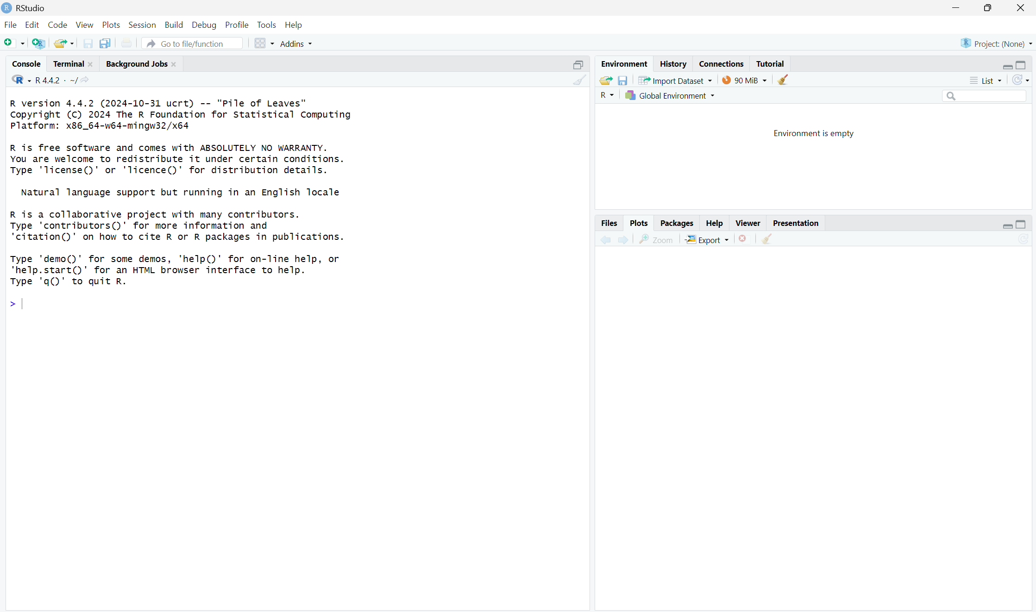
Variables you have created
Plots and files will go here

Slide 4
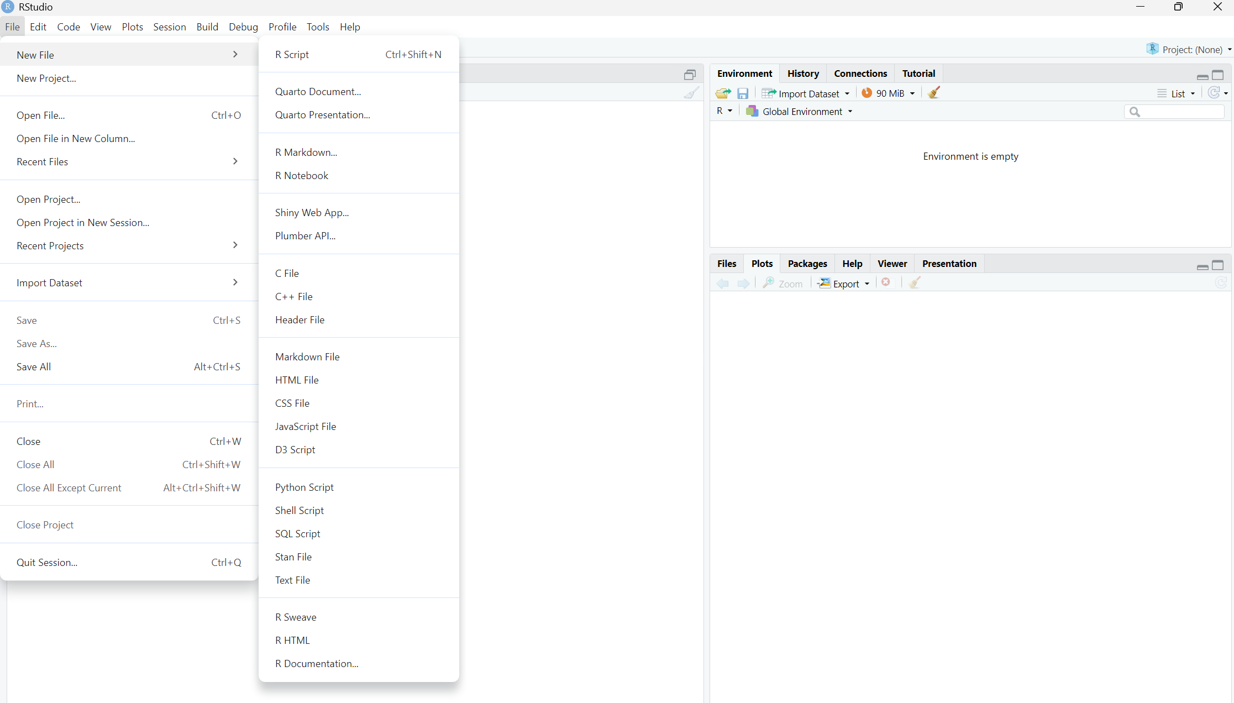

Slide 5
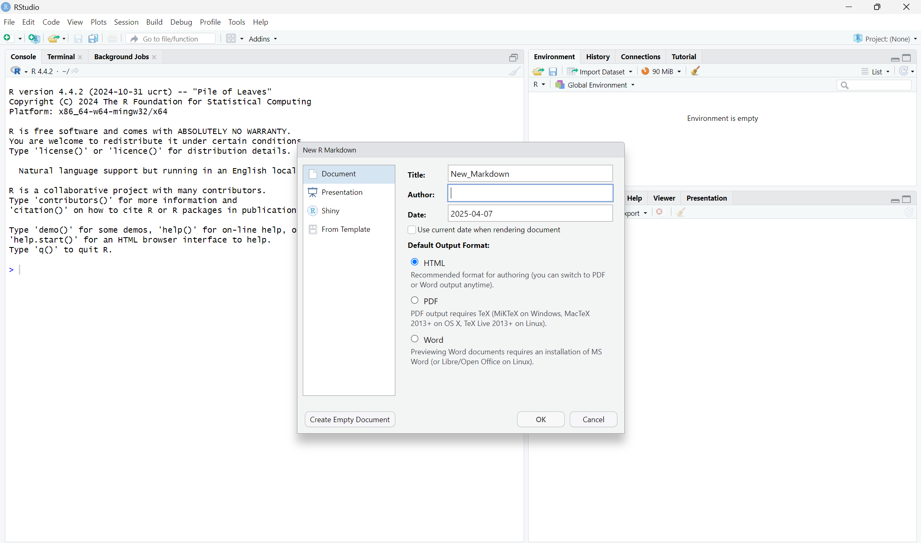

Slide 6
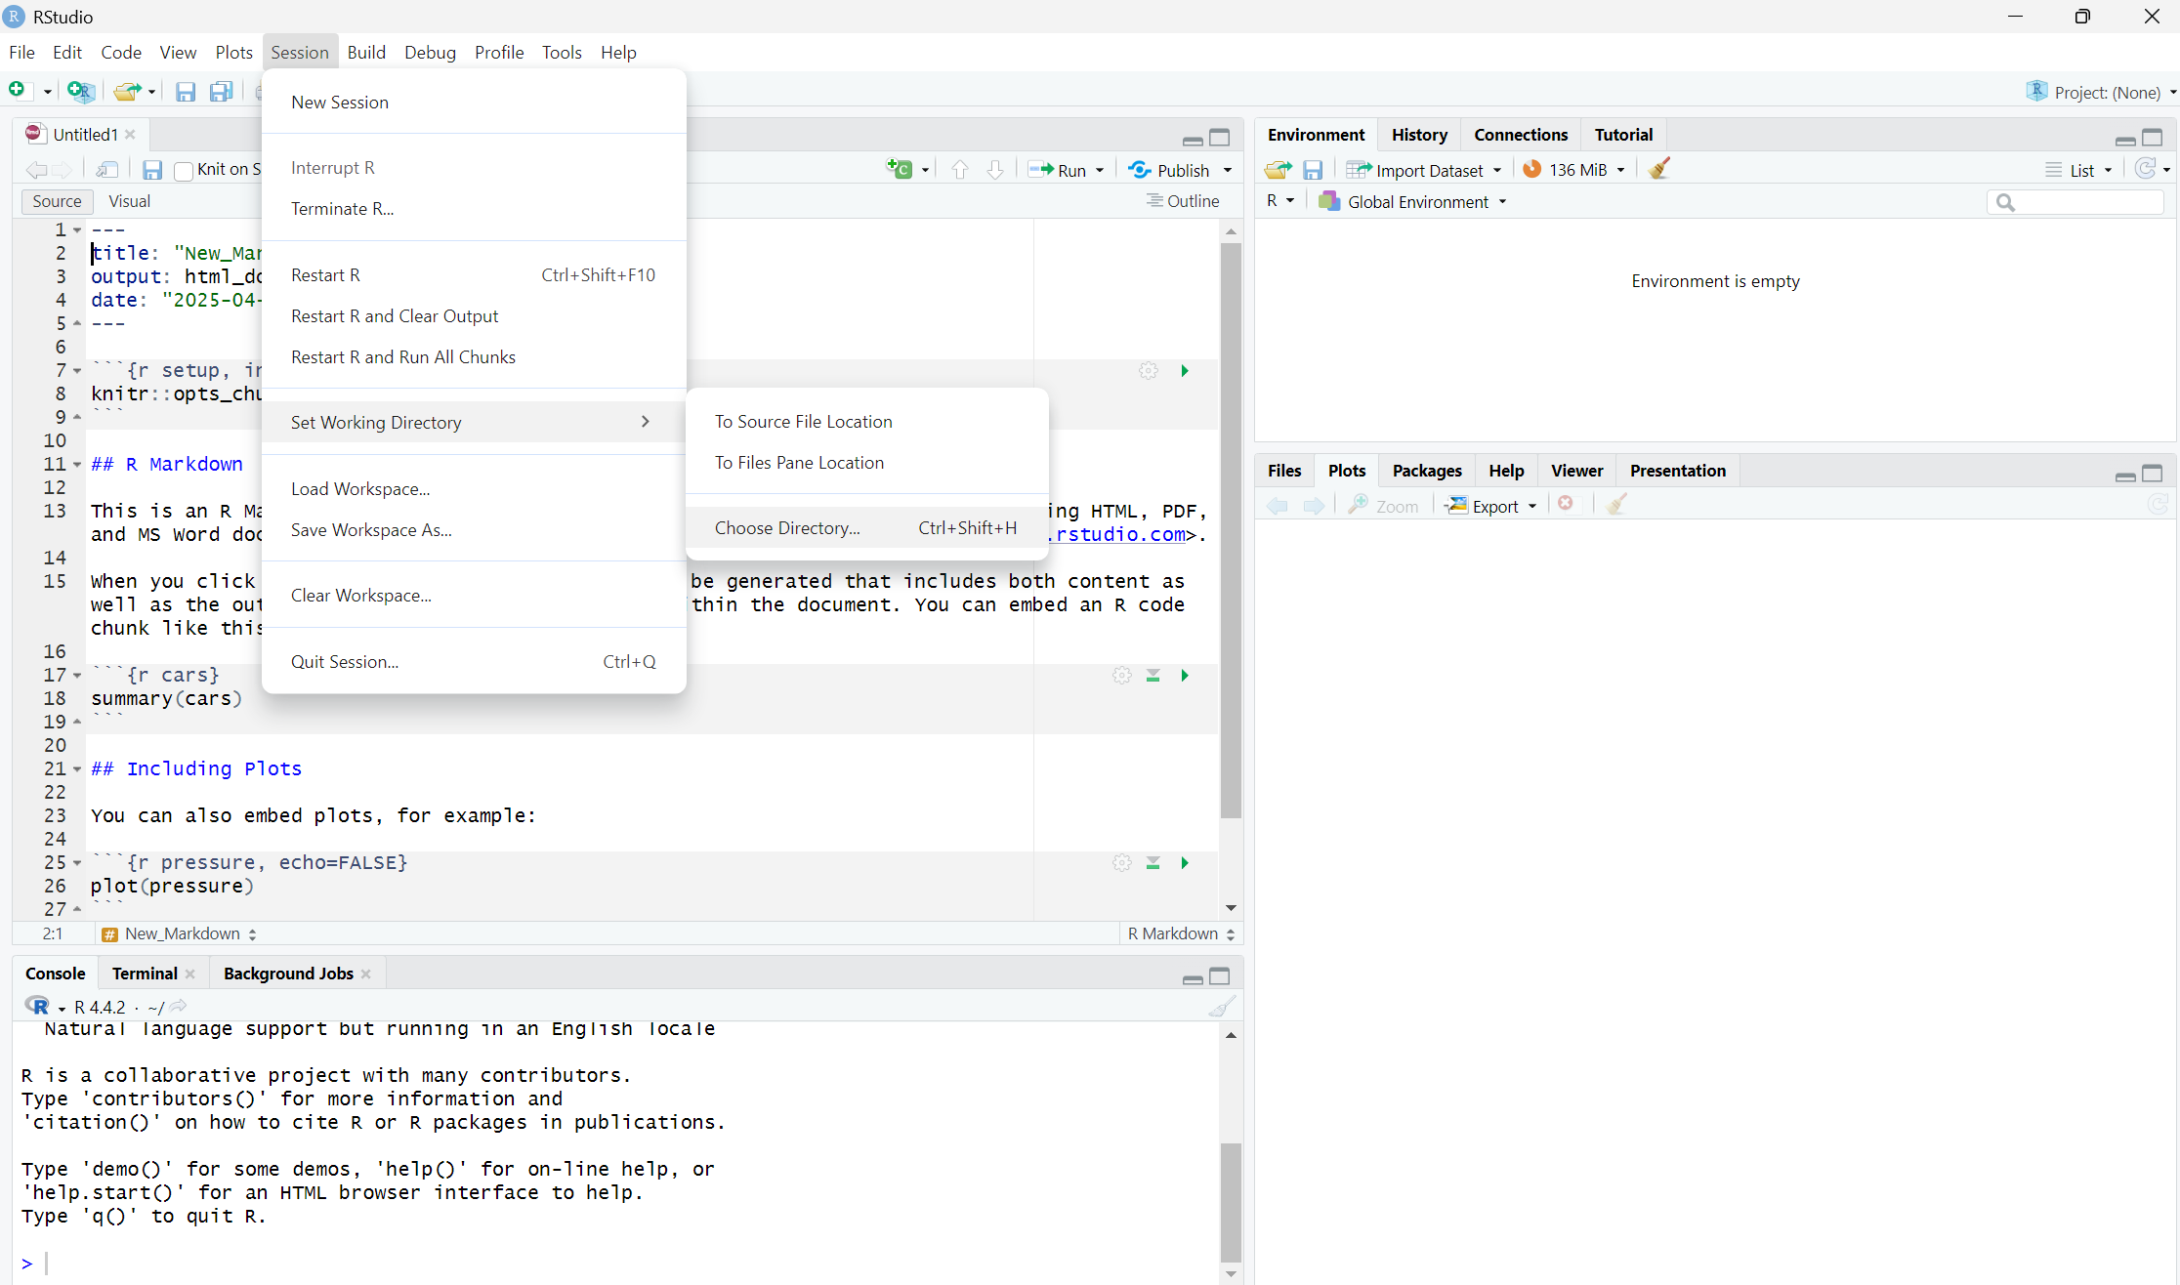
Set working directory

Slide 7
Turing in Assignments in the Correct Format
R studio has its own file type but that is not what we want you to turn in on Canvas. We want a PDF.
Use knit tool
If it will not knit to PDF directly, knit to an HTML and save it to PDF from there by printing to PDF
MAKE SURE NOTHING IS GETTING CUT OFF!
You will lose points if your answers get cut off and we cannot read them

Slide 8
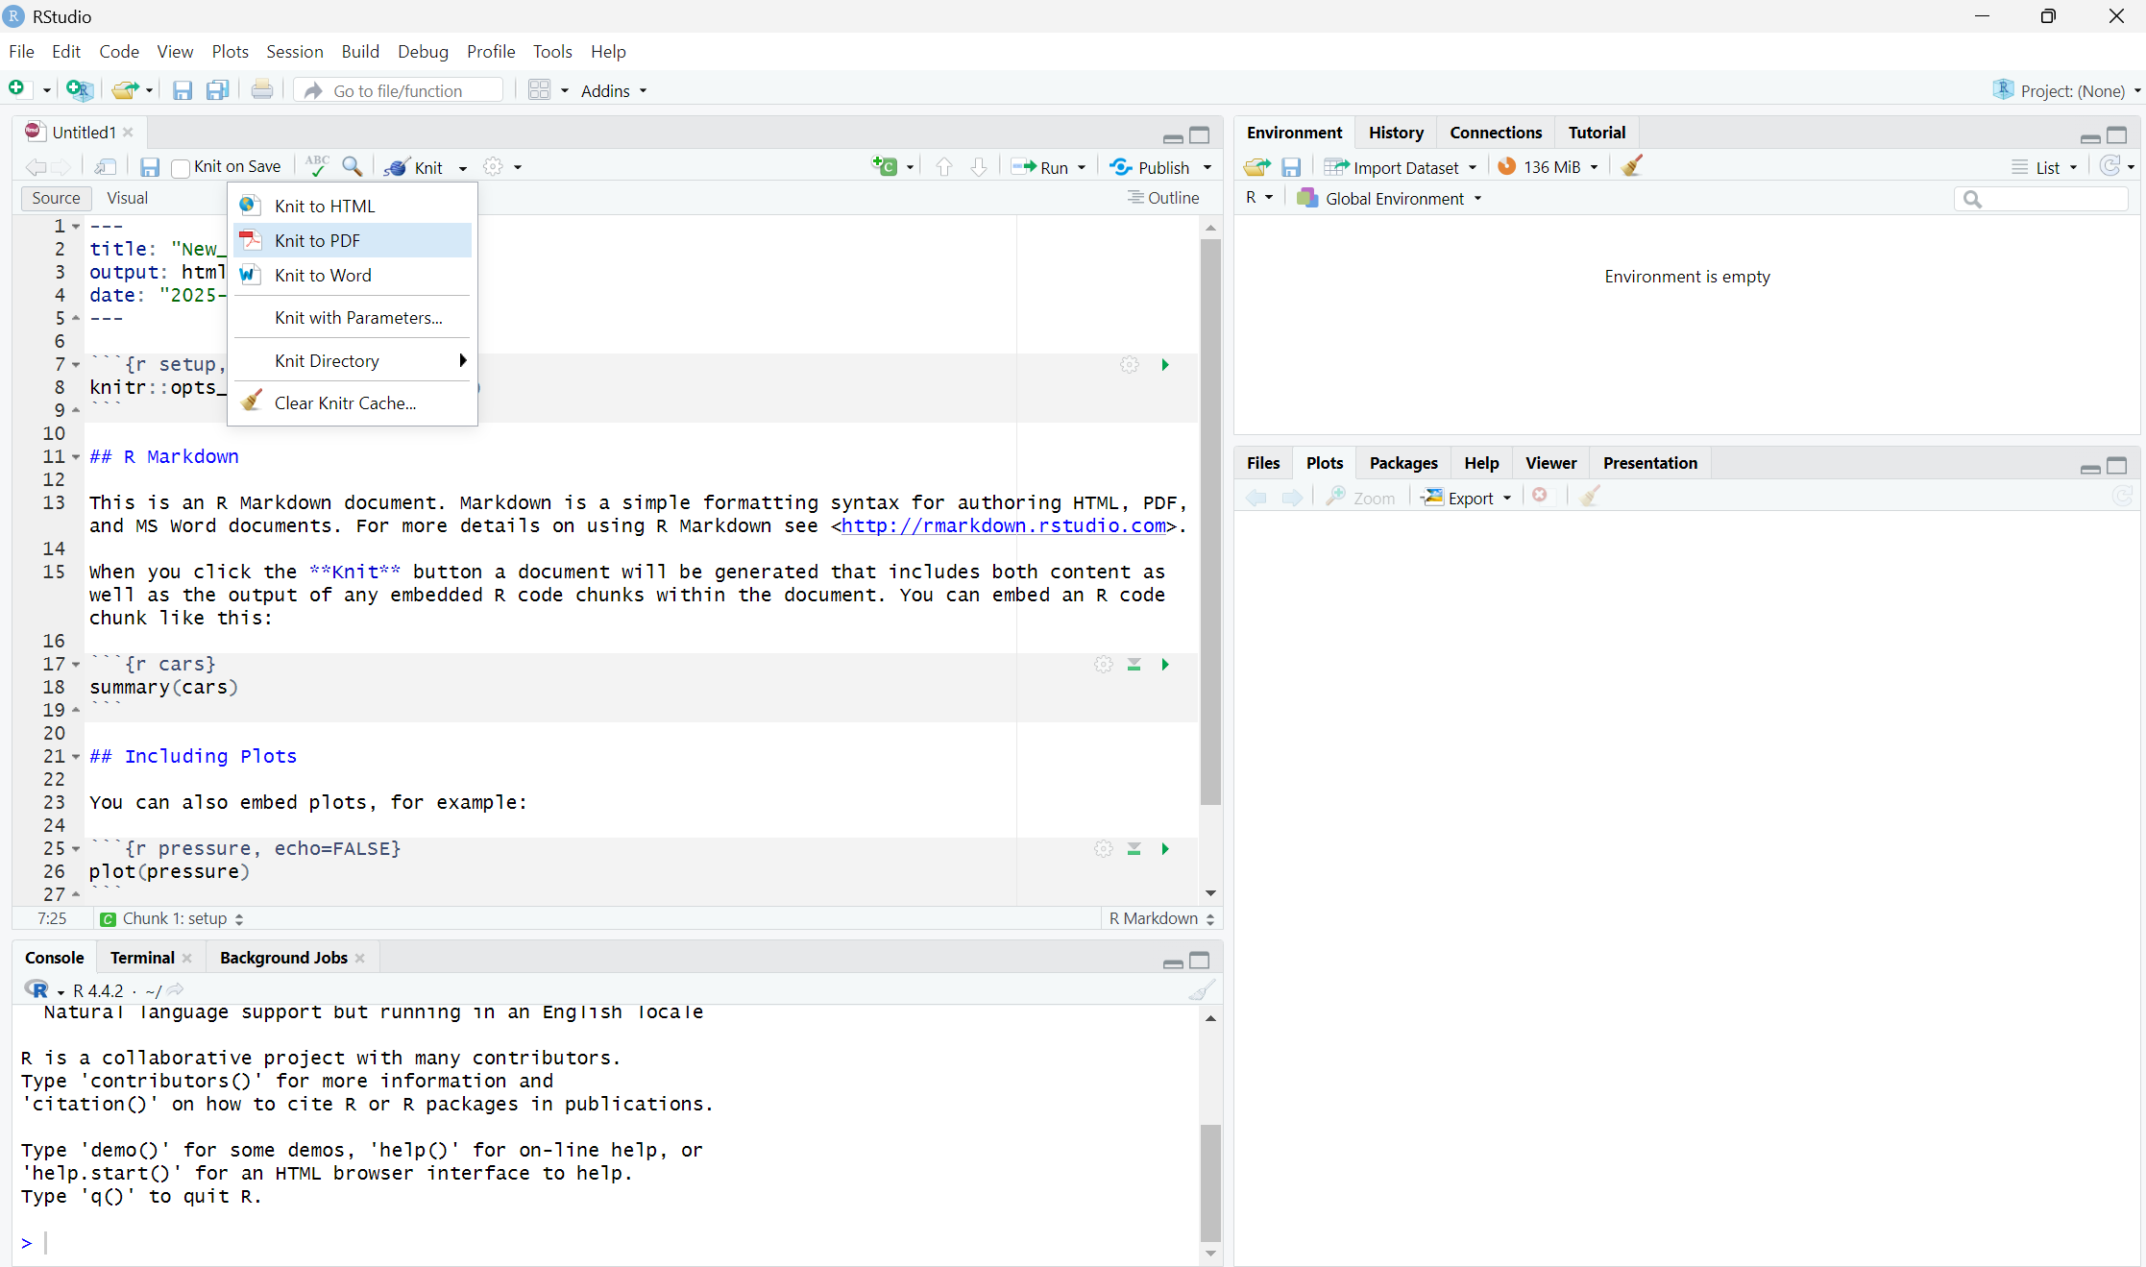
Saving to PDF or HTML

